Slide 1
Introduction to learning theories
SD Murgu
University of Chicago

Slide 2
Purpose & Objectives
Illustrate Kolb’s learning styles in a curriculum design
Learn to implement experiential learning principles in designing CME curricula

Slide 3
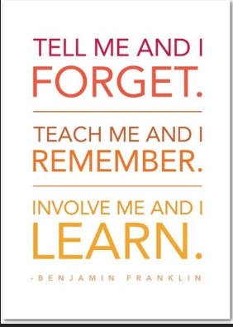
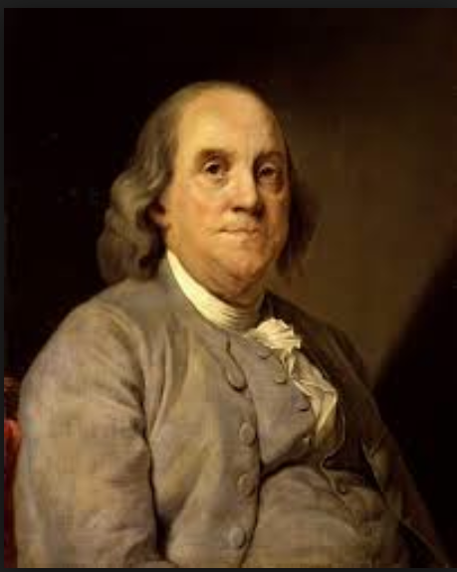
Active engagement leads to durable learning
1706-1790
Notes:
I start with this quote from Benjamin Franklin as this statement is now proven by current research in neuroscience which demonstrates that Experience coupled with attention leads to physical changes in the structure and future functioning of the nervous system” Mike Merzenich and Rob deCharms, 1998
Learning is stronger when it matters. When the abstract is made concrete and personal. Active engagement leads to durable learning.

Slide 4

Background
Implementation of more active and self directed learning strategies to promote the desired change in behaviors
Apply experiential learning model to overall curriculum design
Learner’s new knowledge does not necessarily lead to new behavior
Acad Med. 2005; 80:680–684.
http://www.michaelmccurry.net
Notes:
Lecture based CME programs have proven inadequate for changing physicians' behaviors also probably because retention rate and knowledge gain are poor after such programs. The application of different learning styles in sequence in an educational encounter is the most desirable approach and that this approach to learning could extend far beyond individual learners to influence how every component of medical education is designed, from the individual lecture or class activity to entire courses or programs.

Slide 5

Current questions for curriculum planners
What should be included in the curriculum?
How should this knowledge be delivered?
Why design curricula that foster active learning?
Notes:
These days, curriculum planners are questioning the content of medical education, the methods of instruction and the connection between content and teaching through an understanding of how learning occurs

Slide 6

Kolb ‘s learning styles
Experience as the central role in the learning process differentiated the experiential approach from those of other learning theories
Necessity for learning formats conducive to the majority of learners,
Learners may have learning styles that differ from the preferred style of the instructor
Kolb DA. Experiential Learning: Experience as the Source of Learning and Development.
Englewood Cliffs, NJ: Prentice Hall, 1984.
www.spring.org.uk
Notes:
In 1970, a PhD student at Harvard theorized that differences in the way people learned had to do with the way they perceive and then process an experience. The emphasis on experience as the central role in the learning process differentiated the experiential approach from those of other learning theories.

Slide 7
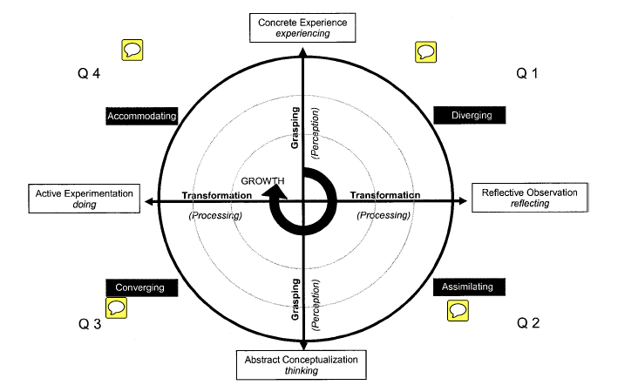
4 Learning styles
interaction
event
theory
idea
Acad Med. 2005; 80:680–684.
Notes:
According to Kolb, two dimensions are necessary for learning to occur. The first dimension is described as a grasping, or perceiving, medium, and the second one as a transformation, or processing, medium. Learning results from the way people perceive and then process that information, making it their knowledge. In this figure, the vertical axis represents perception and may have an event or interaction (“concrete experience”) on one extreme or an idea or theory (“abstract conceptualization”) on the other. The horizontal axis transforms an experience by reflecting on it (“reflective observation”) to the one extreme or processes it by acting upon it (“active experimentation”) to the other extreme.

Slide 8
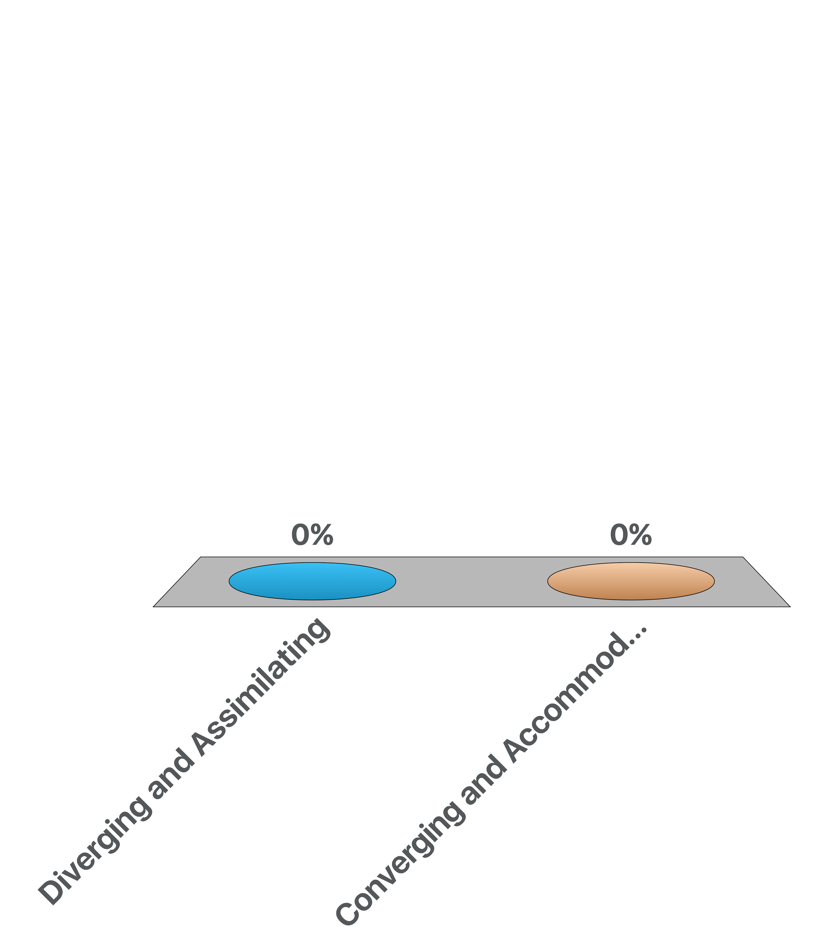
Which learning style is preferred by the majority of physicians involved in medical education?
Diverging and Assimilating
Converging and Accommodating

Slide 9
Although there are 4 Learning styles: Q 3 and
Q 4 preferred by physicians involved in med ed
22%
37%
Acad Med. 2005; 80:680–684.
Notes:
Surveys of physicians involved in medical education shows that ~40% preferred the converging style and another 20% the accommodating one. So, ~ 60% of physicians want to experiment with the new acquired information.

Slide 10
Curriculum Design based on Kolb’s learning styles-address all styles
Notes:
The best design for learning, therefore requires all learners to work in each style in a sequence moving from quadrants 1 to 4 moving from a definition of personal meaning and needs to the acquisition of new knowledge, followed by practical application and then synthesis and extension. So let me illustrate how these different learning styles can be implemented in an educational program.

Slide 11
Curriculum Design based on Kolb’s learning styles
DIVERGING STYLE
Case based lectures
Reflection may be augmented by interactive lectures and use of audience response systems (ARS)
Notes:
Quadrant 1: ARS: through these, the teacher gets to know and care about the participants as individuals. Through activating, articulating, and reflecting what they already know and value, the participants ready themselves to listen to and evaluate the new information the course provides.

Slide 12
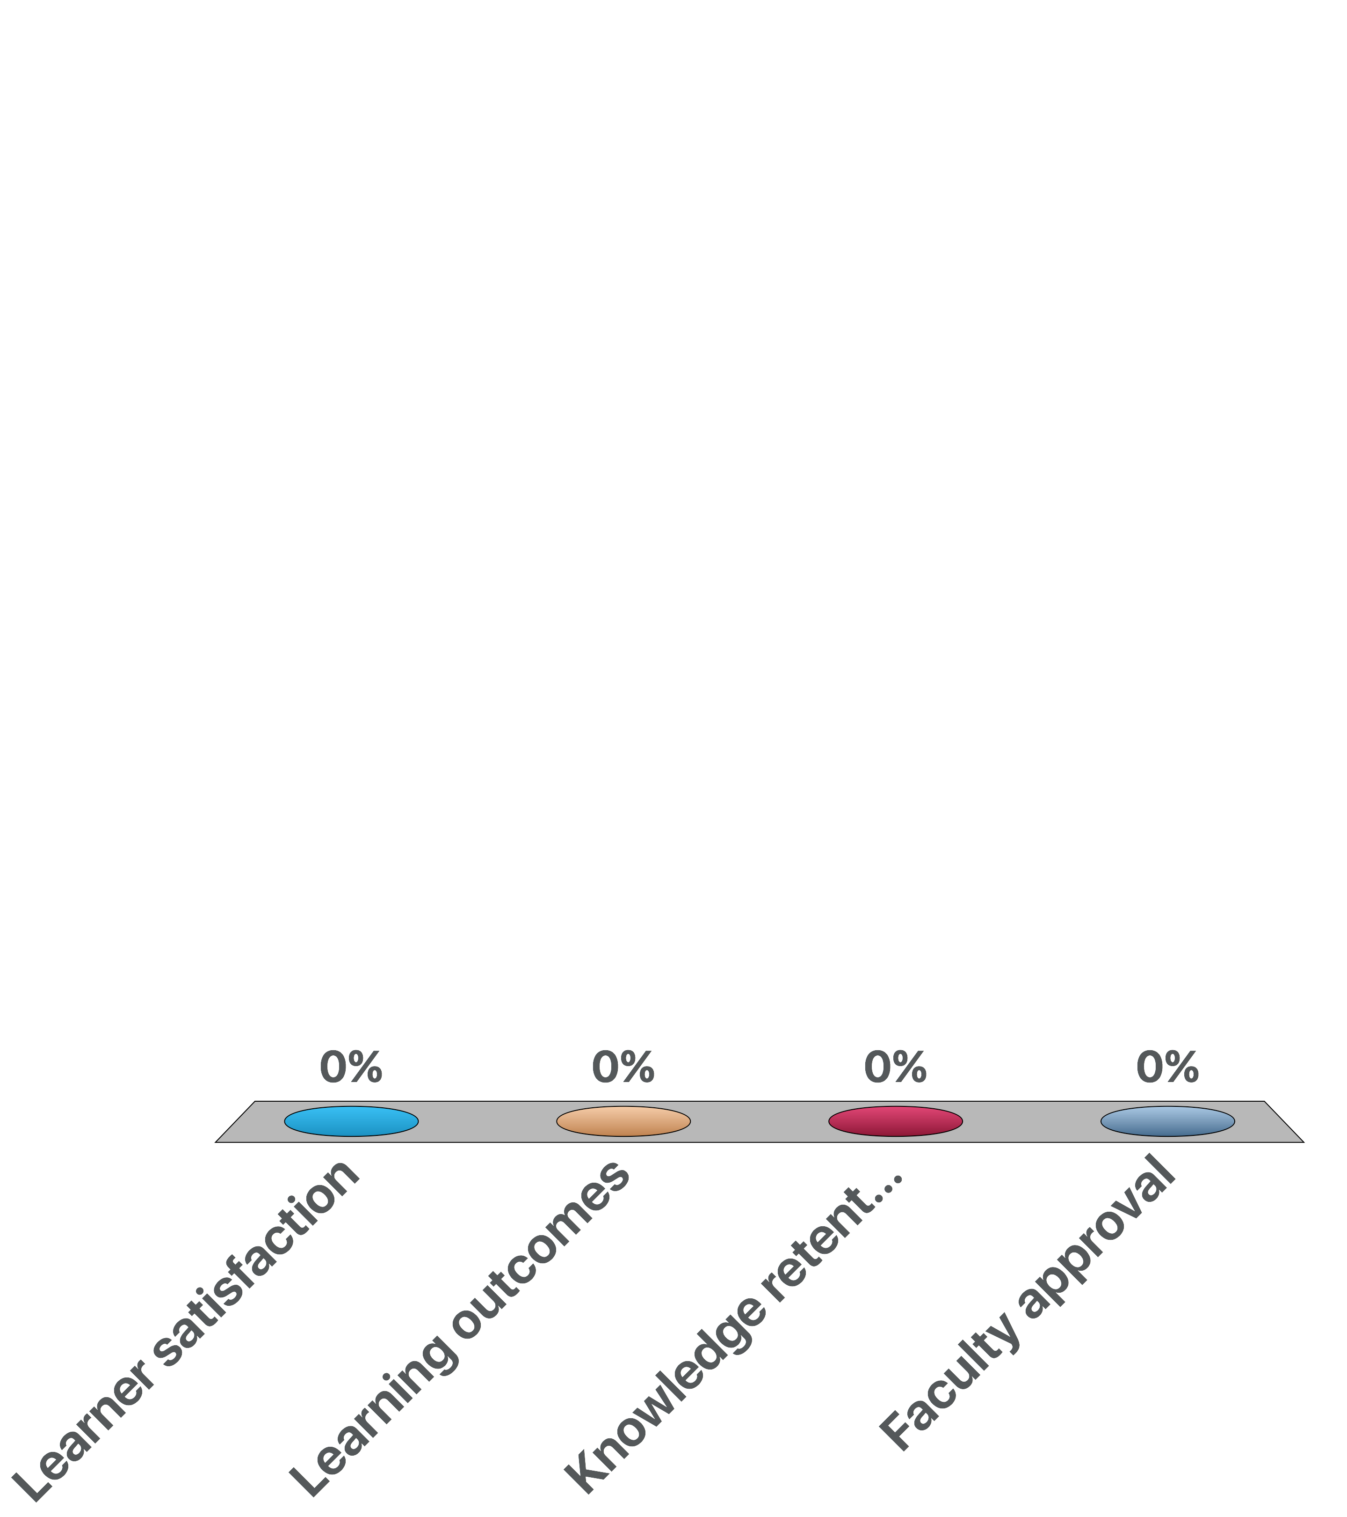
When compared with the didactic lectures, interactive lectures show worse results for:
Learner satisfaction
Learning outcomes
Knowledge retention
Faculty approval

Slide 13
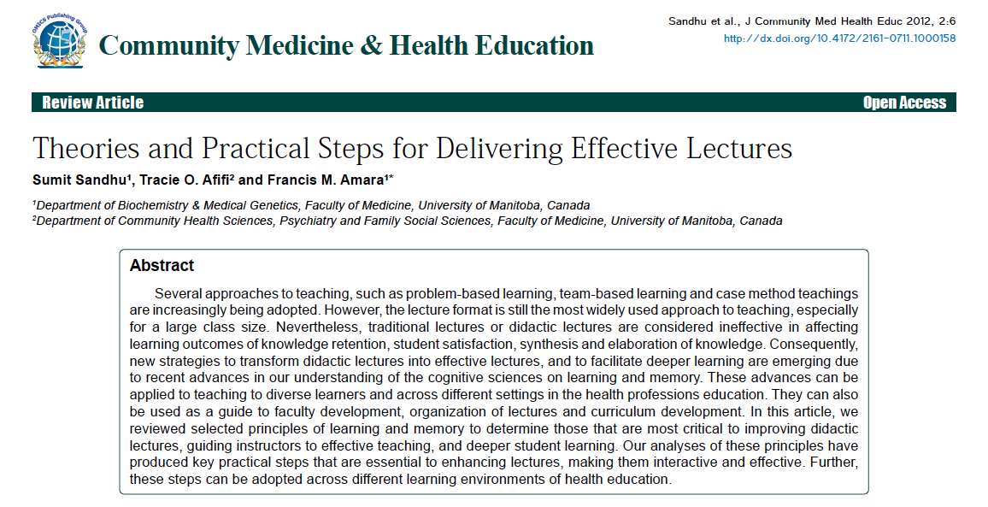
Interactive lectures lead to better retention, better knowledge gain and student satisfaction
Notes:
A review article from an educational journal showed that interactive lectures lead to better retention, better knowledge gain and student satisfaction. Not every faculty, however, is excited about this format, and that may have to do with their own upbringing, education and age.

Slide 14
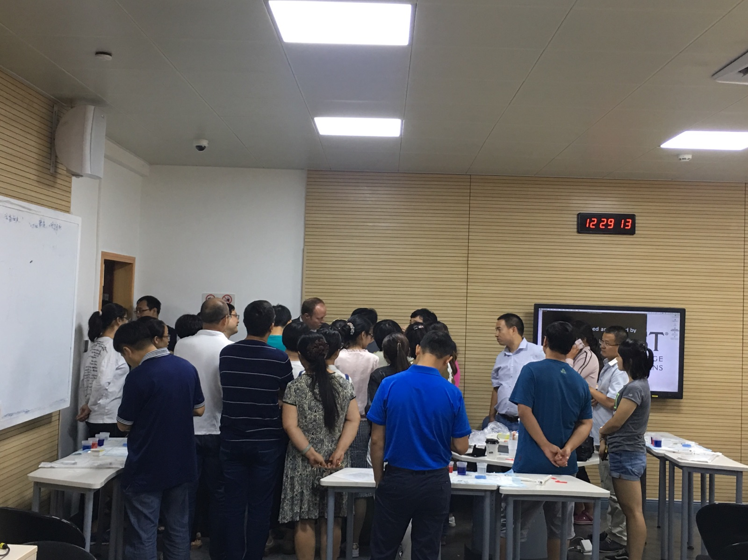
Curriculum Design based on Kolb’s learning styles
DIVERGING STYLE
Workshops but no hands on experience
Learners are observers and may choose not to reflect on what they experience
The instructors demonstrate rather than educate
Notes:
Quadrant 1 may also involve workshops where the instructor demonstrates, and the learners are pure “observers”. While meant to be a hands on session, in this model, the “hands on” is for the instructor not the learners. Not a learner centric approach.

Slide 15
Curriculum Design based on Kolb’s learning styles
ASSIMILATING STYLE
Addresses new knowledge (ideas, theories) through didactic lectures, reference to articles, guidelines
Can be presented in an Interactive format
Interactive format facilitates reflection
Examples:
Flow limitation in COPD
Molecular mechanisms of resistance to TKI
Notes:
Quadrant 2: addresses the new knowledge through interactive lecture, reference to articles, guidelines; of note, most lecture based programs stop here!!

Slide 16
Which learning style is preferred by bronchoscopists?
Diverging and Assimilating
Converging and Accommodating

Slide 17
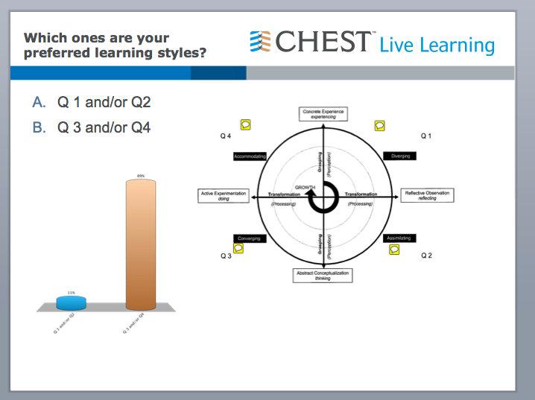
Preferred styles of bronchoscopists
Notes:
We had the chance to ask this specific question at a course on bronchoscopy that we had at CHEST HQ in Chicago. 90% of participants preferred to experiment with the new information

Slide 18
Application of knowledge: try it out!
Creates opportunities to experiment their new knowledge in a safe environment
Problem and game- based exercises
Simulation
Workshops with
HANDS ON
experience
Problem based
Learning
Game-based
Learning
Notes:
Quadrant 3 and 4: application of knowledge; a shift from thinking to doing, moving from theory to practice. The idea is to create opportunities for physicians to experiment with their new knowledge in a safe environment, to put new ideas and skills to the test through PBL, game based exercises and simulation

Slide 19
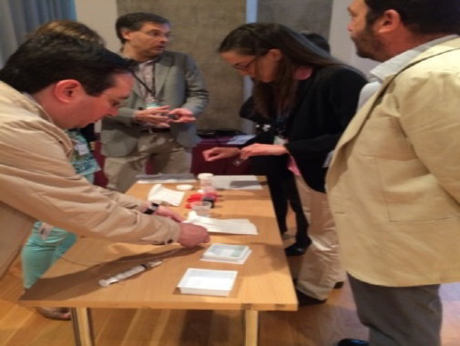
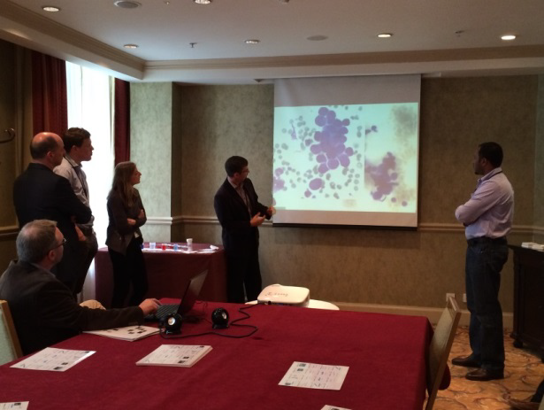
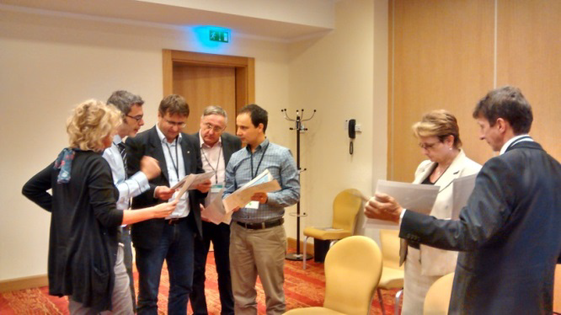
Kolb’s 4th quadrant:
SIMULATION
The classroom is a
laboratory!
Notes:
To address the last learning style, the accommodating, simulation is a potential solution. Learners divided Into small groups and rotated through the breakout sessions, led by expert faculty and educators. The breakout sessions were designed to be hands-on and focused on team interactions.

Slide 20
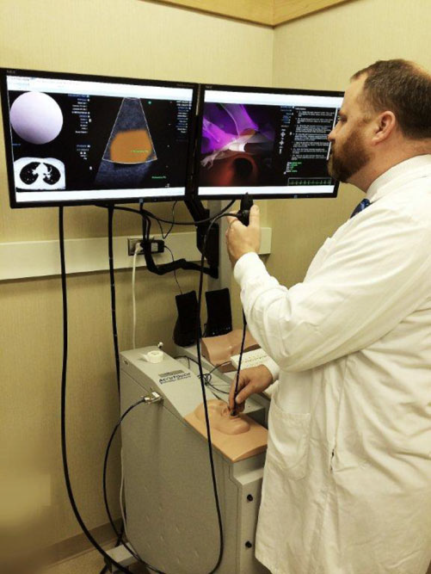
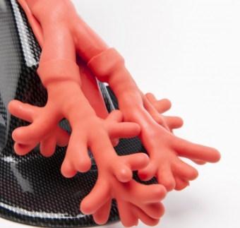
Simulation
High or low fidelity
Costs
Degree of realism
Fielding D, Maldonado F, Murgu S. Respirology (2014) 19, 472–482
Notes:
Simulation can be offered via HF or LF machines. They differ in their degree of realism and costs. A MA with 17 comparative studies unsurprisingly
concluded that in comparison with no intervention, substantial benefits were achieved with simulation in many learning outcomes including skills, behaviors and time to complete a procedure

Slide 21
Simulation
A meta-analysis suggests that low-fidelity models may in fact be preferred in some situations, even though more interesting models may ultimately motivate learners to practice more
Simulation training may actually increase procedural time for trainees, but with improvement of the thoroughness and quality of the procedure
Kennedy CC, Maldonado F, Cook DA. Simulation-based bronchoscopy training: systematic review and meta-analysis. Chest 2013; 144: 183–92.
Fielding D, Maldonado F, Murgu S. Respirology (2014) 19, 472–482

Slide 22
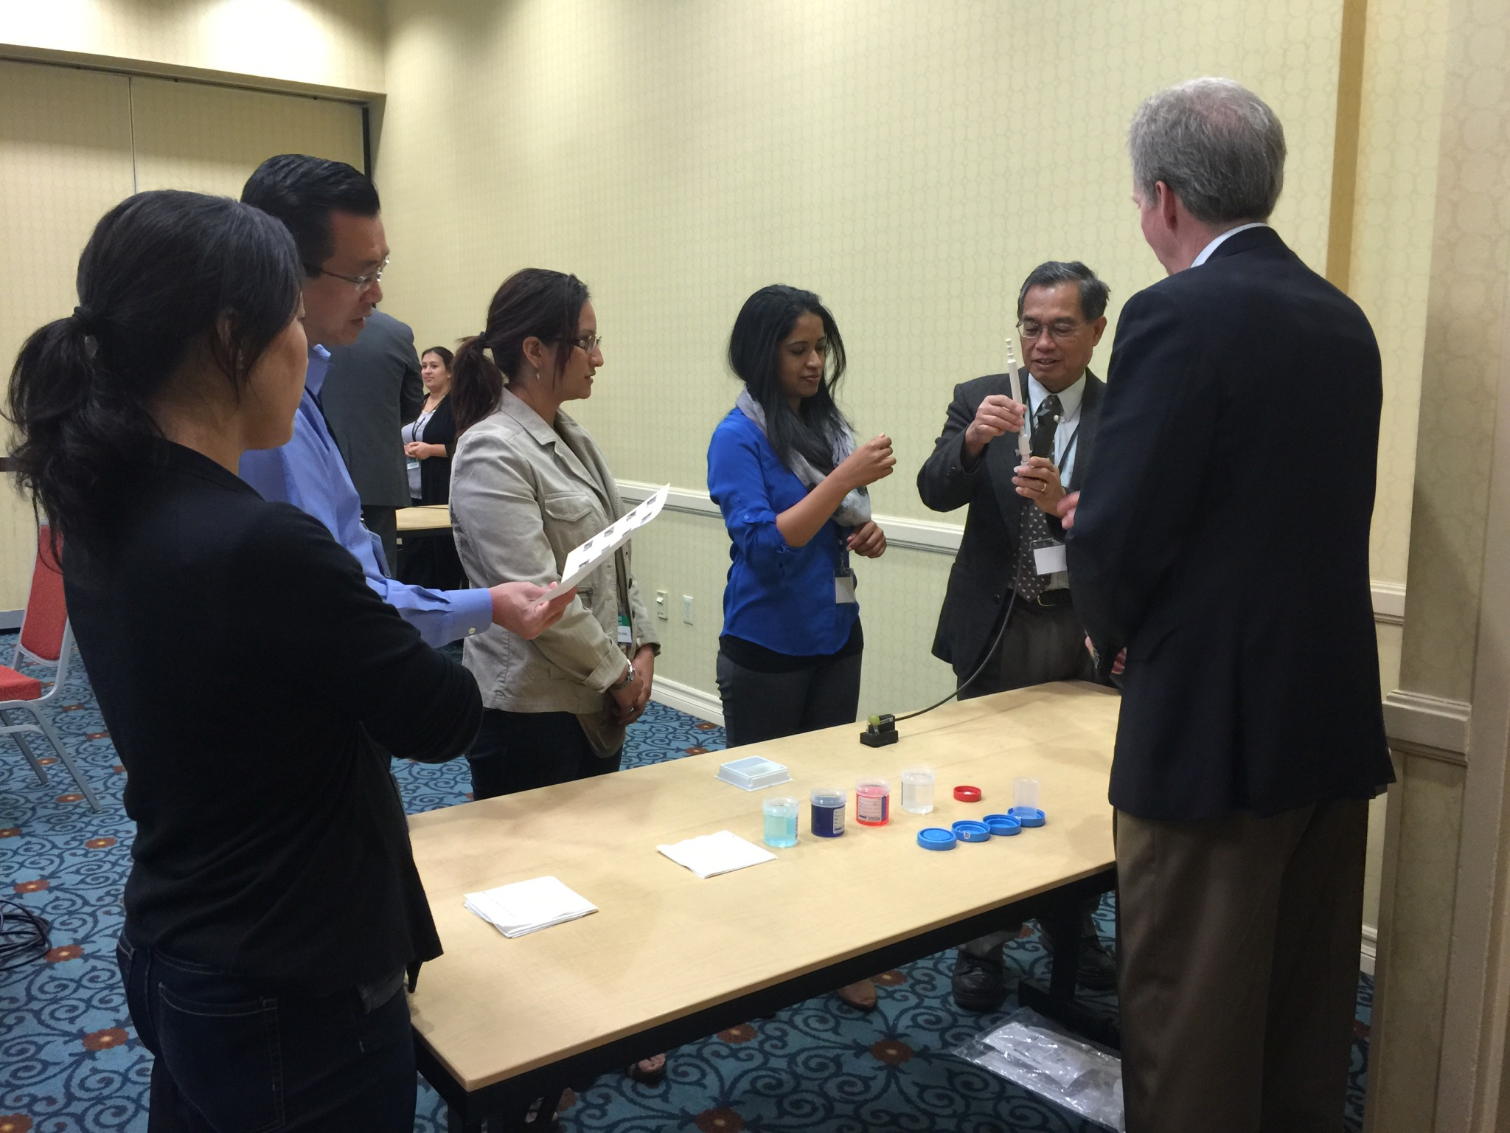
Hands on sessions: structured workflow to engage EACH participant
Describe the objectives and distribute the handouts
Review the tutorial materials
Assign the learners to specific roles that include the following;
  Bronchoscopist
  First Assistant
  Second Assistant
  Checklist reader
  Time Keeper
Notes:
Each hand son session has clarly defined workflow for consistency of teaching. Each participant is engaged by having an assigned role.

Slide 23
Examples: GAIn Agenda
8:30–9:00 AM Registration and Breakfast
9:00–9:15 AM Welcome, Introductions & Summit Overview
9:15–10:00 AM Tumor Board Presentation/Discussion of Cases
10:00–10:55 AM Breakout #1: Mediastinal Anatomy
Breakout #2 15 Steps of Bronchoscopy
Breakout #3: Slide Preparation
Breakout #4 Pathology Analysis
10:55–11:10 AM Break
11:10 AM–12:05 PM Breakout #1: Mediastinal Anatomy
Breakout #2 15 Steps of Bronchoscopy
Breakout #3: Slide Preparation
Breakout #4 Pathology Analysis
12:05 PM–12:35 PM Lunch
Notes:
This is an example of an agenda on how we implemented these concepts to Lung Cancer education. GAIN-.‐Europe was a 6‐hour highly interactive live meeting focused on enhancing cross.‐disciplinary collaboration among physicians for effective NSCLC diagnosis, assessment, and treatment. This sequence was chosen because In the ideal learning process, learners start with a concrete experience
The live education featured a flipped classroom with online pre-work, hands‐on breakout sessions, and an interactive problem‐based learning exercises featuring simulation of a multidisciplinary tumor board.

Slide 24
Agenda (cont)
12:35–1:20 PM PBL Workgroup Discussion & Presentation Preparation
1:20–2:35 PM PBL Presentations from Workgroups / Q&A
2:35–2:55 PM Summit Wrap-up
Notes:
and involve themselves fully, openly, and without bias. Then they reflect upon it and observe it from many perspectives.

Slide 25

Notes:
This is another example from a course on bronchoscopy for intensivists. While didactic lectures are still present in an interactive format, the program was highly focused on simulation and hands on experience. In addition, any valid training program incorporates objective measures of knowledge and skills acquisition. Formative assessments are an essential component of our educational programs. These are both cognitive and technical skills assessments. They offer an opportunity for 360 degree feedback by reflecting objectively on your abilities and techniques and assist you take informed decisions regarding your strategy to achieve competency. Formative assessments are necessary for a standardized evaluation of participants.

Slide 26
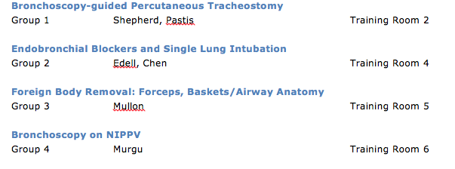

Slide 27
Experiential learning theory at
CHEST courses- Outcomes
CHEST Courses- Greenstein YY et al. Chest 2017
GAIN projects- Murgu SD et al. Chest 2018
Domain Task Forces- Airway, Bronchoscopy courses-work in progress

