Slide 1
Teaching the Teachers:
The Role of Objective, Structured Teaching Simulations
CHEST / APCCMPD Symposium: Best Practices in Faculty Development
CHEST 2018
Sunday, October 7, 2018
David Schulman, MD, MPH, FCCP
Emory University School of Medicine

Slide 2
Introduction
OSTEs provide a method for evaluation of specific teaching competences with direct feedback given at the end of each encounter
Many potential areas to explore:
    Giving feedback to trainees / exploring reasons for deficiencies / identifying improvement plans
    Moderating / mitigating conflict between parties
    Identifying and intervening with burned out / impaired residents
Assessment can involve a combination of feedback from learner, actor and facilitator

Slide 3
Things to Consider
Ideas
Constructing the Scenario
Space
Assessment Tools
Actors
Preceptors
Participants

Slide 4
Ideas
Recent Experiences
Interdisciplinary issues
  Making tough choices
  Difficult conversations
Outcome goals versus process goals
Evaluation metrics

Slide 5
Constructing the Scenario
This is basically writing a screenplay
  Storyboard MORE IMPORTANT than script
Many possible pathways through the exercise
  Improv background helpful

Slide 6
Constructing the Scenario
Case information, including objectives
  May include branching scenarios
Room set-up, necessary equipment

Slide 7
INSTRUCTIONS FOR TEACHER:
Resident Name: Kristen Miller, M.D.
It is 8:30 AM on the first day of your pulmonary ward month and you are beginning work rounds with your resident with her first new patient; she has already been on service for the last two weeks. You are outside the room of Mr. Walker, a 71 year-old man with COPD admitted last night for shortness of breath, diagnosed with a pneumonia and COPD exacerbation. He is seen by one of your colleagues in clinic; he has severe obstructive physiology (FEV1 0.7 liters) and chronic hypercapnia (baseline pCO2 55 mm Hg). His home regimen includes tiotropium, fluticasone / salmeterol , theophylline and prn albuterol. He does not use oxygen at rest, but uses it at night and with exertion.
Conduct work rounds on the patient up to the point at which you would go to see him. Include teaching and feedback as appropriate. You have a total of 35 minutes for this exercise.

Slide 8
STANDARDIZED INTERN INSTRUCTIONS
Personality: Your name is Kristen Miller; you are an intern in internal medicine. It is midway through your first year, and it has been rough so far. You would describe yourself as an average resident with a decent fund of knowledge, but you have difficulty integrating medical facts into a differential diagnosis as readily as other interns seem to do. Though these facts have been confirmed by constructive feedback you’ve received from faculty, you haven’t been able to make much progress. As a result, you tend to put a great deal of faith into the sign out that you get from others, sometimes failing to review their thought process as closely as you should. You are a team player, and are easy to work with. You are receptive to constructive feedback.
The Scenario: You are currently midway through your pulmonary ward month, and a new fellow is starting today. You admitted a patient from the Emergency Department overnight; Peter Walker is a 71 year-old man who is regularly followed in the pulmonary clinic. The Emergency Department called him in with an admitting diagnosis of COPD exacerbation, right lower lobe pneumonia and dehydration. His presenting complaints were shortness of breath, weakness and chest pain, all of which started about an hour before he came in to the ED. He

Slide 9
Fidelity
The extent to which the appearance and behavior of the simulation matches the appearance and behavior of the simulated system
    Physical Fidelity
      Manifestation of room layout, equipment, manikin quality (in some cases)
    Emotional Fidelity
      Feelings and emotions generated from interactions
          Need to be flexible

Slide 10
Types of OSTEs
Orienting a learner
Outpatient precepting
Bedside teaching
Constructive feedback
Inpatient teaching
Teaching charting
Teaching a procedure
Giving a mini-lecture

Slide 11
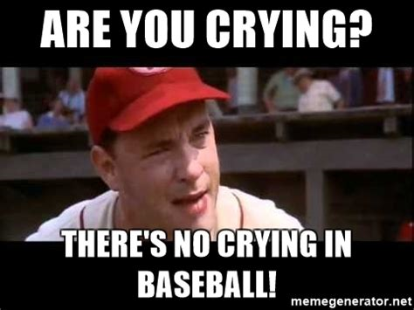
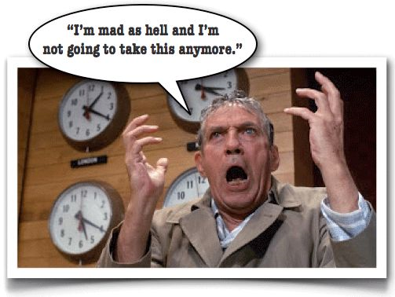
Twists to Consider
(Real-Life / Level ups)
The learner has an undisclosed challenge
    Physical
    Social
    Psychological
  The learner may not be very good
    And may not be aware that they are not
  The learner has a different agenda than the preceptor
  The learner may just be resistant

Slide 12
Space and Recordings
Could theoretically be done in a clinic room or an office
Advantage of the facilitator outside of the room
Advantage of recording (and later playback / peer review)

Slide 13
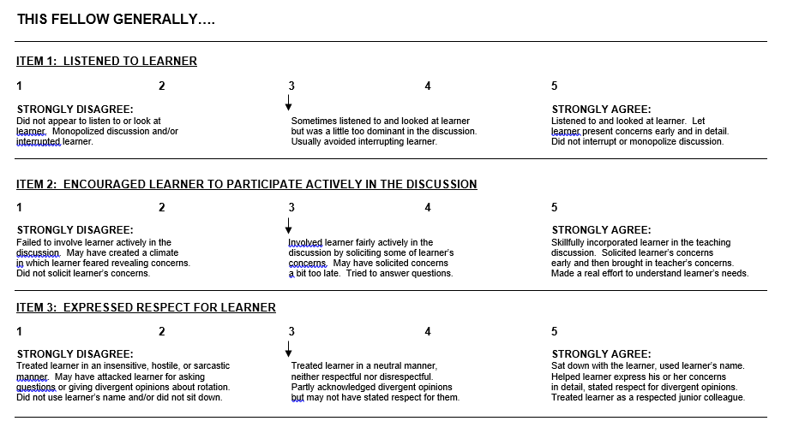
Assessment Tools
Standardized forms a MUST
The faculty member:

Slide 14
Actors
Most institutions have a pool of local talent
  Lack of medical knowledge
The advantages and disadvantages of using housestaff
Several dress rehearsals

Slide 15
Faculty Preceptors and Willing Participants
Getting buy-in
  This has been the biggest challenge
  For all or for some?
  Departmental mandate?
  Incentives?
  External preceptors may decrease resistance

Slide 16
Some take-home messages
Use real life examples that were problematic for you (or other faculty) in the past
Ensure high fidelity by thinking through multiple ways the scenario could go (understanding several might be “correct”)
3. Find the actor. Train the actor. Practice multiple times with the actor.
4. Encourage / incentivize faculty to participate.

Slide 17
Specific examples I have used
Learner struggling due to external stressors
Learner working with a challenging staff member
Learner with significant misconceptions about pulmonary physiology
Encouraging learner to challenge faculty member

